Slide 1









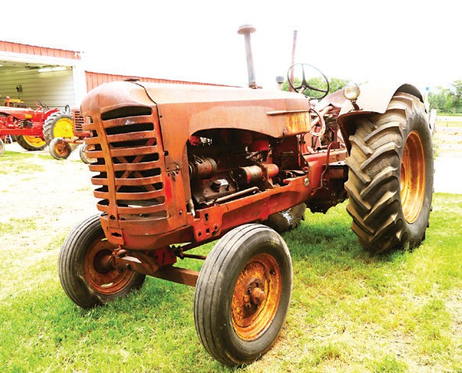

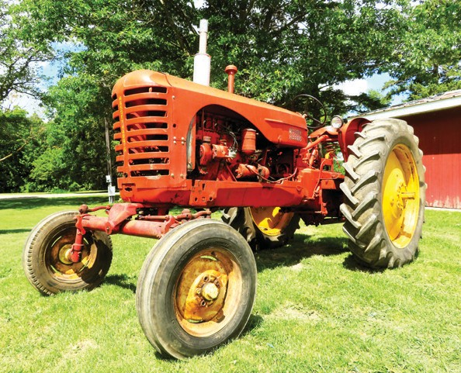
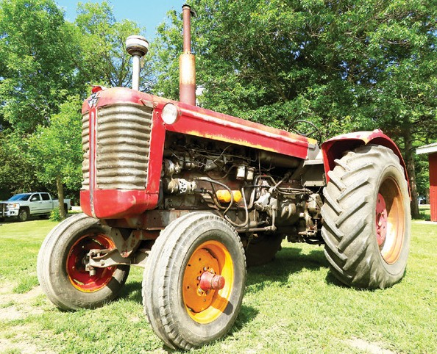








Massey Harris Collection
LOCATION: 1323 Maple Drive SE, Alexandria, MN 56308
OPENS: MONDAY, AUGUST 31
CLOSES: WEDNESDAY, SEPTEMBER 9 | 7PM
PREVIEW: By Appointment / LOADOUT: By Appointment
TRACTORS
Massey Harris 555 wide front, diesel, hyd.,
540 PTO, power steering, rear fenders, 7.50x18 front tires, 18.4x34 rear tires, S/N23371, recent work including injection pump rebuilt
Massey Harris #444 444G1RF wide front, gas, 1 hyd., 540 PTO, 12v rock shaft, 6.5x16 front tires, 14.9x38 rear tires, powerslide rear wheels, S/N70578, running order
Massey Harris 444 wide front, gas, 3 pt., 540 PTO, 6:00-16 front tires, 14.9x38 rear tires on power slide wheels, S/N73394, engine loose- non running
Massey Harris 33 tractor, for parts only Massey Harris #30 narrow front, gas, hyd., 540 PTO, belt pulley, rear fenders, 5:00-15 fronts, 11-38 rear tires, S/N4493, running order
Massey Harris 30GR tractor, tricycle front, S/N7793, for parts
Massey Harris #30 tractor, for parts
Massey Harris #22 narrow front, gas, rear fenders, 4.90x15 front tires, 13.6x26 rear tires, S/N3130, runs
Massey Harris 22 tractor, w/hyd. system, for parts
Massey Harris #20 narrow front, gas, 540 PTO, 4.00-15 front tires, 10-28 rear tires
RAKES
(2) Massey Harris #11 rake, low wheel, side
delivery
Massey Harris #11 rake, high wheel, side delivery
SICKLE MOWERS
Massey Harris #6 sickle mower, 7’
PARTS
Tractor splitting stand
Massey Harris side shields for Massey Harris mounted corn picker, will ﬁt a 33 or 44 Massey Harris misc. parts for a Massey
Harris 22 & 55 belt pulley, gas tank, hood, etc. Massey Harris misc. parts for a Massey Harris 30, grill, gas tank, etc.
Massey Harris misc. parts Misc. plow lays & mole boards
Massey Ferguson 97 coulters, tricycle front end, grills
Massey Harris 555 parts, hyd. pump, steering arm, hood, gas tank, belt pulley, grill
Minneapolis Moline wheel weights Massey Harris 33 engine, loose Massey Harris add on bottom plow Massey Harris hitch, 3 pt., for a 33 or 34
Massey Harris #33 parts, grill, hood, radiator Steel Skeleton spade wheels, will ﬁt a Massey Harris Challenger #33 or #34
TIRES
(2) Massey Harris 14-34 tires on spider dual
rims
(2) Massey Harris 11.2x34 tires on 8-hole rims
(2) Massey duals, torch cut
Massey Harris 101 Sr. Standard, wide front,
540 PTO, belt pulley, rear fenders, 5:50x16 front Massey Harris Pony wide front, one bottom
tires,14.9x26 rear tires, loose, does not run Massey Harris 101 Jr. narrow front, gas, belt pulley, 5:00-15 front tires, 11.2x36 rear tires, S/N393089, runs
Massey Harris #97 wide front, diesel, 2 hyd., 540 PTO, power steering, rear fenders, 7.5-18 front tires, 18.4x34 rear w/band duals, runs, engine rebuilt, trans. rebuilt
Massey Harris 95 wide front, diesel, hyd., 540 PTO, power steering, rear fenders, wheel weights, 7.5x18 front tires, 18.4x34 rear tires, running order
Massey Harris #81 narrow front, gas, 540 PTO, S/N405425, runs
Massey Harris #55 55G1SF Standard, wide front, gas, 1 hyd., 540 PTO, rear fenders, 7.50- 18 front tires, 18.4x34 rear tires, S/N14193, running order
Massey Harris #44 wide front, gas, hyd., 540
mounted plow, 5’ mower, draw bar, one row crop cultivator, rear wheel weights,5-15 front tires, 9.5-2 rear tires, S/N27637, runs
DRILL
Massey Harris double disc grain drill, 10’
CORN PICKER
Massey Harris self-propelled corn picker,
gas engine, 2x40”, 10-24 front tires, 6:00-15 single rib rear tires, S/N15323
PLOWS
Massey Harris #28 pull-type plow, 4 bottom,
new tine, trip lift, totally rebuilt
Massey Harris #28 pull-type plow, 3 bottom, hyd. lift, no cyl.
(2) Massey Harris# 28 pull-type plow, 3 bottom
Massey Harris plow, 3 bottom, trip
PTO, rear fenders, 5.50x16 front tires, 13.6x38 Massey Harris mounted plow, 3 bottom
rear tires, S/N11315, runs, rebuilt wheels Massey Harris 44 wide front, gas, hyd., 540 PTO, 13.6x38 rear tires, does not run, engine stuck
Massey Harris 44 six Standard, wide front,
IHC pull-type plow, 2 bottom
Massey Harris plow, 1 bottom, ﬁts Pony tractor ^{(2) Goodyear 13.6x26 tires}
Massey Harris pull-type plow, 2 bottom
Massey Harris #28 plow, 2 bottom
(3) 10-28 tires
Misc. tires, 5.5-16, 7.50-18
(2) Massey Harris pull-type plow, 2 bottom
gas, 540 PTO, rear fenders, 6.50-16 front tires, _{Massey Harris plow, 2 bottom}
14.9x30 rear tires, engine stuck
Massey Harris 44 Special wide front, gas, hyd., 3 pt., 540 PTO, rear fenders, 6.5x16 front tires, 12.38 rear tires, S/N51554, incorrect decals, running order
Massey Harris #33 33G1RF wide front, gas, 540 PTO, 6:00-16 front tires, 12.4-38 rear tires, S/N10610, completely rebuilt engine & trans., running order,
Massey Harris #33 narrow front, gas, 540 PTO, 1 hyd., 5.50x16 front tires, 13.6x38 rear tires, runs
Melroe plow, 5 bottom, trip beam
DISCS & CULTIVATORS
Massey Harris disc, 18’
Massey Harris pull-type disc plow
(2) Massey Harris 4-row mounted cultivator,
drive through
Massey Harris cultivator, 2 row, ﬁts 81, 20, & 22 (two pallets)
BERNIE VAN ZOMEREN | 320.760.0826
or Scott Gillespie at Steffes Group, 320.693.9371
or 320.760.3066
Complete terms, lot listings and photos at SteffesGroup.com Scott Gillespie MN47-007
SteffesGroup.com
Steffes Group, Inc., 24400 MN Hwy 22 S, Litchfield, MN 55355 | 320.693.9371

